Slide 1
Textile data analysis
Project report by Samiksha

Slide 2
Step 1:
1. 📥 Importing Required Library
import pandas as pd
The script starts by importing pandas, which is essential for handling data.

Slide 3
Step 2:
2. 📂 Reading the Dataset
df = pd.read_csv(r"C:\\Users\\Samiksha\\Downloads\\WICVOCDataAll_030223.csv\\WICVOCDataAll_030223.csv")
A CSV file containing textile data is loaded.
Make sure the path exists on your machine if rerunning this code.

Slide 4
Step 3:
3. 🔍 Initial Exploration
df.head()
df.info()
df.describe()
df.columns
head(): Shows the first few rows of the dataset.
info(): Displays data types, number of non-null entries.
describe(): Statistical summary for numeric columns.
columns: Lists all column names

Slide 5
Step 4:
📉 Missing Value Analysis
df.isnull().sum()
This checks for the number of missing values in each column. Done twice for cross-verification.

Slide 6
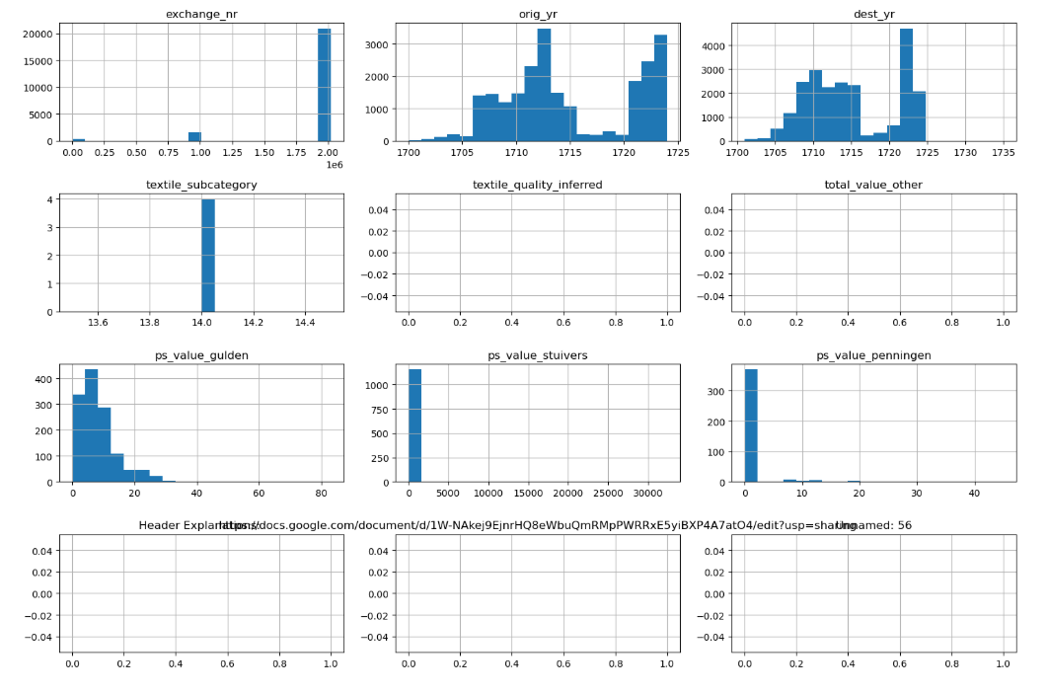
Step 5:
5. 🧾 Exploring Categorical Variables
It used for represent categorical data
The given data presented in histogram
for col in df.select_dtypes(include='object').columns:
print(f"{col}: {df[col].nunique()} unique values")
Prints the count of unique values in each categorical column.

Slide 7
Step 6:
6. 🧹 Data Cleaning
Remove Duplicates
df.drop_duplicates(inplace=True)
Removes repeated rows
Handling Missing Data (Suggested)
# df.fillna(method='ffill', inplace=True)
This line is commented out, suggesting forward-filling could be used to handle null values

Slide 8
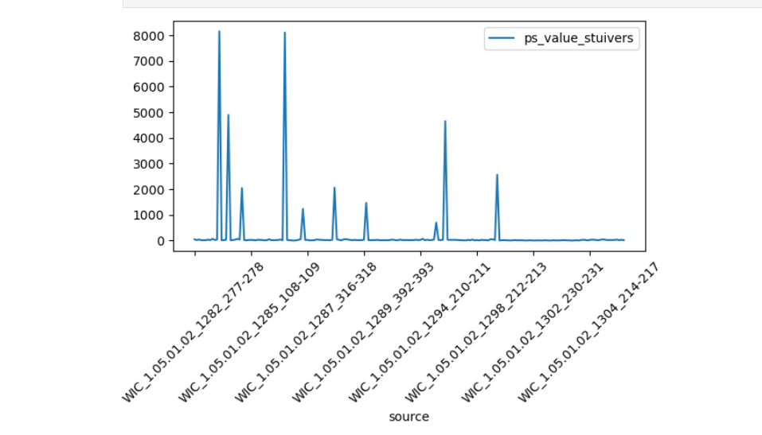
Step 7:
7. 📊 Visualizing Numerical Data
df.hist(figsize=(15, 10), bins=20)
plt.tight_layout()
plt.show()
Creates histograms for all numerical columns to understand their distributions.
This is line graph representataion of data

Slide 9
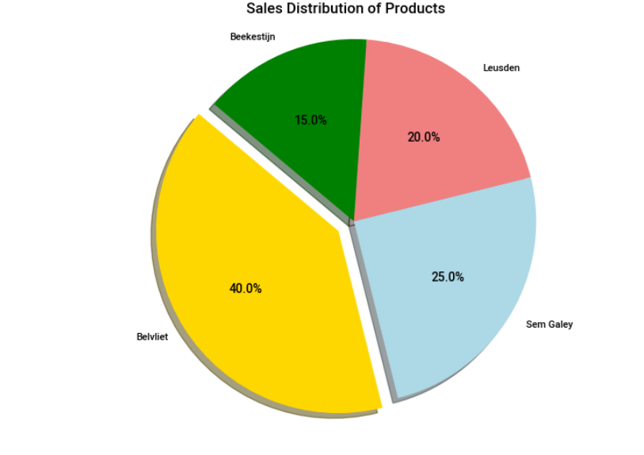
Step 8:
8. 📈 Categorical Visualization (Suggested)
# sns.countplot(data=df, x='CategoryCol')
This is a suggested count plot using Seaborn, currently commented

Slide 10
Step 9:
9. 📉 Group-Based Aggregation
df.groupby('means_of_exchange')['ps_value_stuivers'].mean()
Calculates the average value (ps_value_stuivers) grouped by the method of exchange.

Slide 11
Step 10:
10. 🏭 Company Count
df['company'].nunique()
Finds how many unique companies exist in the dataset.

Slide 12
✅ Summary & Insights
Dataset contains trade or textile data with both categorical and numerical fields.
Duplicates removed.
missing values assessed.
Numerical distributions plotted.
Aggregation gives average values based on exchange method.
Unique company count extracted.

Slide 13
Thank you

